Slide 1
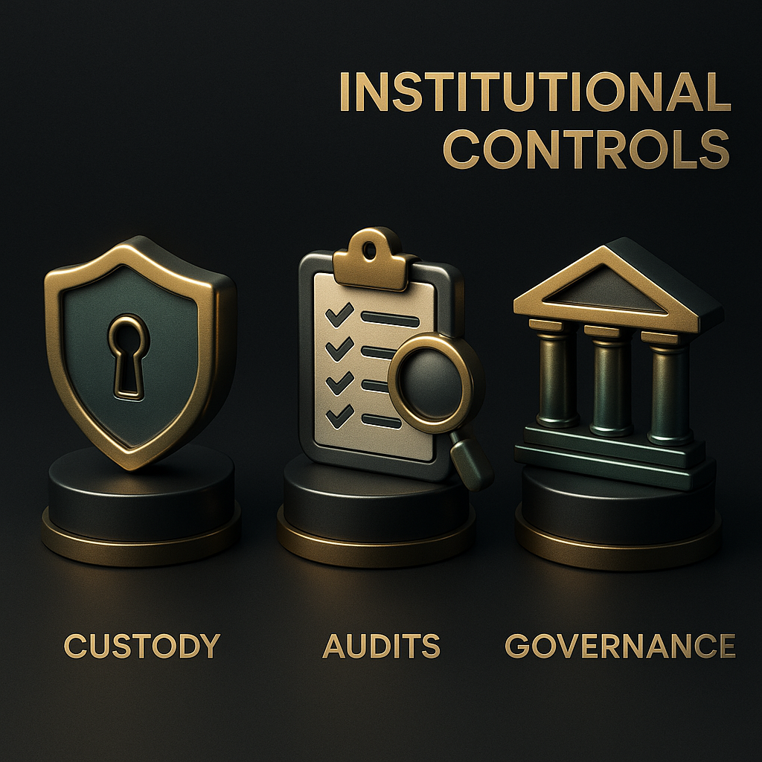
Compliance-Native Infrastructure for Institutional Markets
ETF-ready architecture · Custody-grade controls · Governance transparency
Notes:
Replace placeholder with institutional-hero-3d.png (full-bleed). Keep watermark center at ~3% opacity.

Slide 2

ETF Readiness Architecture
Xarva’s compliance-native architecture connects XCVM (NAV engine) to Institutional Custody and ETF Trusts,
ensuring real-time NAV verification, proof-of-reserves, and audit-ready transparency across both CEX and DEX environments.
Notes:
Place image at ~70% width. Title top-right. Animate blocks left→right, arrow glow.

Slide 3
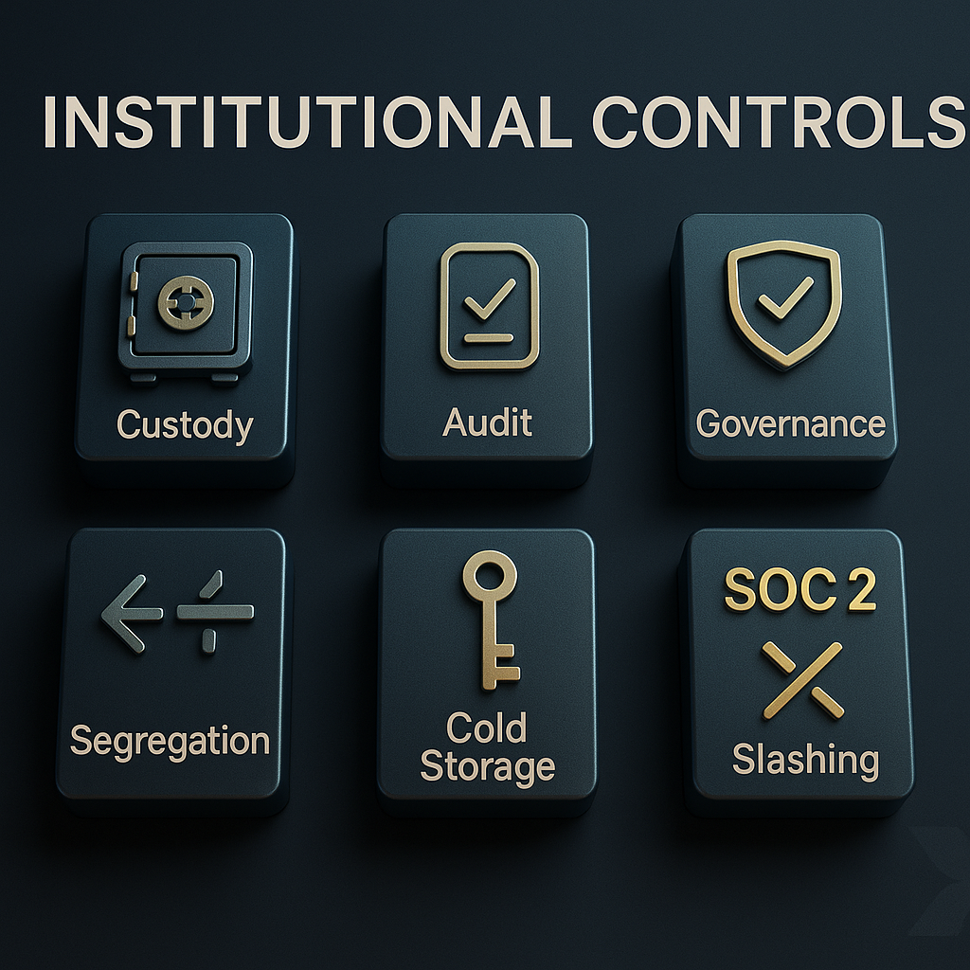
Institutional Controls Overview
Xarva embeds SOC 2-aligned custody, audits, and governance segregation directly at the protocol layer—creating verifiable trust for institutional participants.
Notes:
Center image at 65–70% width. Stagger icons Custody→Audits→Governance.

Slide 4

Governance Transparency & On-Chain Audit
Governance decisions, compliance policies, and audit events are stored immutably on-chain via the XCVM policy registry, creating a public, verifiable record of institutional accountability.
Notes:
Left-weighted visual; put caption to the right. Panel slide-in sequence.

Slide 5

Institutional Adoption Roadmap
A phased pathway from Validator infrastructure → Custody enablement → Exchange integration → ETF conversion, positioning Xarva as the compliant bridge from DeFi to TradFi.
Notes:
Full-width visual. Trace golden arrow; pulse ETF endpoint.

